Slide 1
SOW development studies (draft)

Slide 2
Waste Characterization Study
Objective
In general, a waste characterization study defines the composition of the waste and ensures that:
The calorific value of the waste is known. This is a basic variable for a valid business case of the WtE plant; needs to be completed with deviations from the mean, especially regarding pollutants (HCl, SO₂, Hg etc.) and CV.
Composition of the waste is determined according to valid methods.
Scope or Work
Sampling plan
  Plan defines sampling method; population determination, area, number of samples, locations, intervals, etc
  To be executed in 2 sampling campaigns (dry season wet season), and or other seasons when relevant
  Method for bomb- calorific instrument and the equipment used for grinding
Sampling according to EN15442 methods for sampling of solid recovered fuels. The sample size 300 kg and each sample should consist of 12 increments of approximately 25 kg, or according to ASTM D5231-92 determination of the composition of unprocessed MSW
Sorting according to EN15440 Methods for the determination of the biomass content of solid recovered fuels
Sample preparation according to EN15443 methods for sample preparation of solid recovered fuels
Analysis & Reporting (interim report after first sampling campaign required)

Slide 3

Permit analysis
Objectives
The permit analysis will provide guidance to the project with respect to the countries permitting process, permit requirements and regulatory obligations for the proposed activities. Permits are defined as all permits, licenses, approvals, provisions, and notifications necessary to allow legal start of the proposed activities.
The analysis shall cover all types of regulatory submittals (at all levels that apply – national, local) and it will also cover the different phases of the activities (i.e. construction, operations).
Scope or Work
The permit analysis report must contain:
Framework. A summary of the regulatory framework that applies to the project components.
Permitting process. Provide detailed specific information about the key permitting process. Also, it will provide flowcharts and descriptions of the
  various steps
  ministry interactions / input that would need to occur
  timing of activities
Permitting requirements. Data requirements to be developed / gathered for each step / permit
Regulatory Agencies. Provide a summary of each of the applicable regulatory agencies that provide support and approvals with which the project must engage at various intervals. Present a brief description of these agencies and their primary role.
Summary of Regulatory Submittals. This is a table that breaks down all the applicable regulatory submittals that apply to the Project.

Slide 4

Grid Study
Objective
In general, a grid study is to develop an interconnection scheme between the HE WtE Power Plant and the projected transmission line / network, for stable and reliable evacuation of electrical power
Results of the grid study will be the needed for electricity generation license.
Scope or Work
Load Flow and Contingency Analysis
Steady-state analysis
Reporting, including:
  Interconnection with national grid, distance and name of nearest grid;
  Capacity transmission of the grid;
  Grid stability for on of power evacuation, check for redundancy of connections
In later stage; Dynamic and transient stability analysis
Overview of regulations, standards and norm for electrical installations

Slide 5

Environmental and Social Impact Assessment (ESIA)
Objectives
inform decision-makers and the public of the environmental consequences of implementing the WtE plant.
identify, predict, and analysis of the impacts on the environment and people in the project area of influence.
identify alternatives and mitigation measures to reduce the environmental effect of the WtE plant.
EIA process plays significant role in the overall decision-making by promoting transparency and public involvement
Results are needed for construction / operational permits & funding
Scope or Work
Assessment of:
Policy, legal, and administrative framework
Project description
Baseline data
Environmental impacts
Social impact
Analysis of alternatives
Environmental Management Plan (EMP). Covers mitigation measures, monitoring, and institutional strengthening
Report, including executive summary with concisely discusses significant findings and recommended actions.
According to IFC Performance Standards

Slide 6
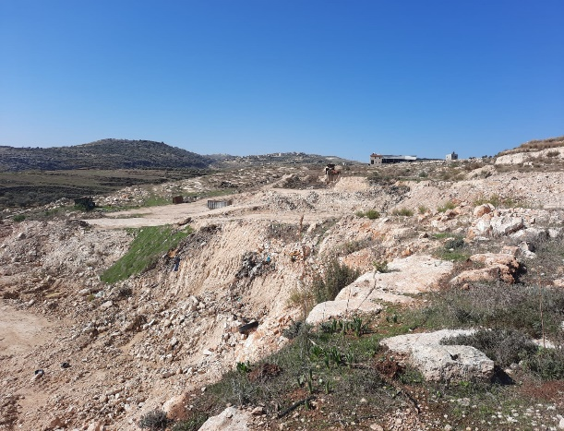
Geotechnical / Topographical Study
Objectives
To determine if all the conditions are met for a sound and environmentally safe construction on the proposed site
Scope or Work
Soil investigation study
Composition of soil layers
Geotechnical study
Aviation limits
History and artifacts
Determine if there is war legacy
Availability of water

Slide 7
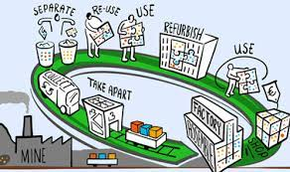
Waste Management Study
Objectives
To determine the future development of the waste composition and calorific value
Scope or Work
Recycle potential in the current MSW
Current waste management strategy and collection schemes
Population (current, expected, economic, wealth, etc.)
Policies, regulations and waste management strategies (in development)
Financial structure for waste management

Slide 8
Other Studies [TBD]
Objectives
Map Logistics
Availability of Resources / chemicals (lime, bicarbonate, ammonia, active coke)
Scope or Work
Determine logistic obstacles from Port of call to project site
Permits for special transports
Availability of resource materials (chemicals; lime, bicarbonate, ammonia or urea, active coke, nitrogen)
Hazardous landfill opportunities
Legislation around leaching in relation to bottom-ash reuse in tiles and sewage piping.

